Slide 1
MART MANAGEMENT SYSTEM

Slide 2



THE TEAM
Ismail Qayyum
Mohamed Abbas
Noufal Ehaab
21K-3118
21K-3052
21K-3001

Slide 3

OUR PROJECT
EZ MART
We have developed an online mart system which has 3 different user interfaces: admin, customer and seller respectively. Our project demonstrate the basic implementation of an online shopping experience.

Slide 4


WHAT WE ARE WORKING ON
GUI
WHOM THIS APP IS FOR?
HOW OUR DATABASE WORKS?
We are using Java Swing, the most commonly and easy to use GUI
Providing customer and seller an online market solution for selling and purchasing goods
We are using CSV file to manage the stock of the sellers and the credentials of all users.

Slide 5
ABOUT THE GUIs’ IN JAVA
JAVA FX
JAVA SWINGS
APACHE PIVOT
SWT

Slide 6
WHY JAVA SWING?
Provides both additional functionalities and added components to AWT-replacement components.
Swing components are platform-independent.
Swing components can use a different look and feel.
Swing components use the Model-View-Controller paradigm (MVC) and thus can provide a much more flexible UI.

Slide 7
Java Swing Components
Jframe
JPanel
JTable
JScrollPane
JButton

Slide 8
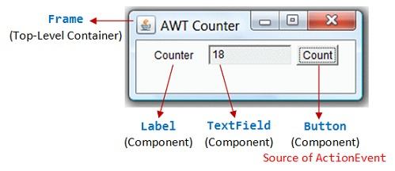
JAVA COMPONENTS

Slide 9
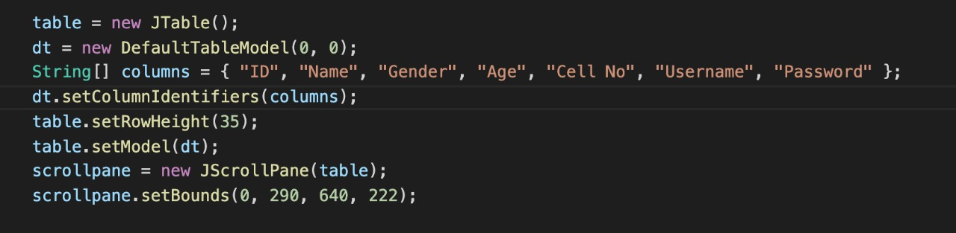
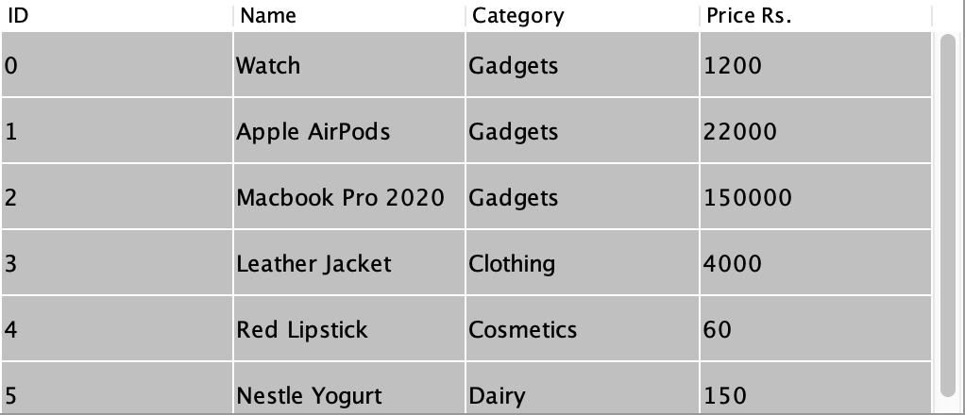
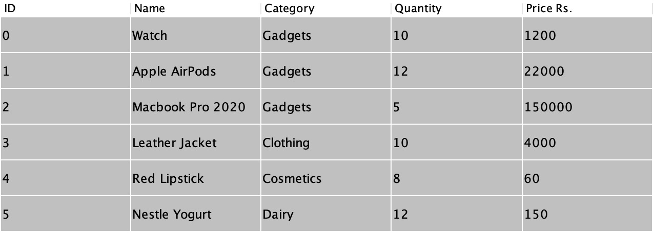
JTable and JScrollpane

Slide 10
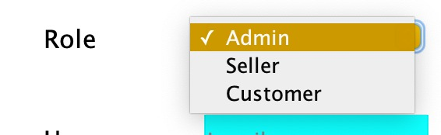
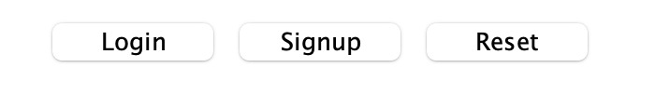
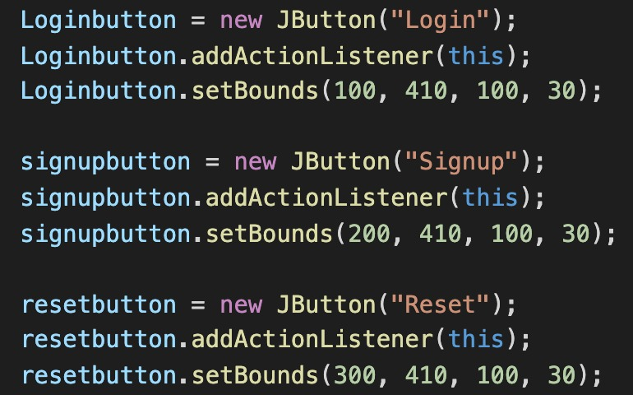
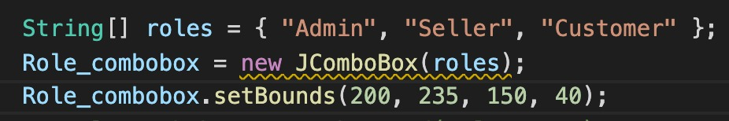
JComboBox and JButton

Slide 11
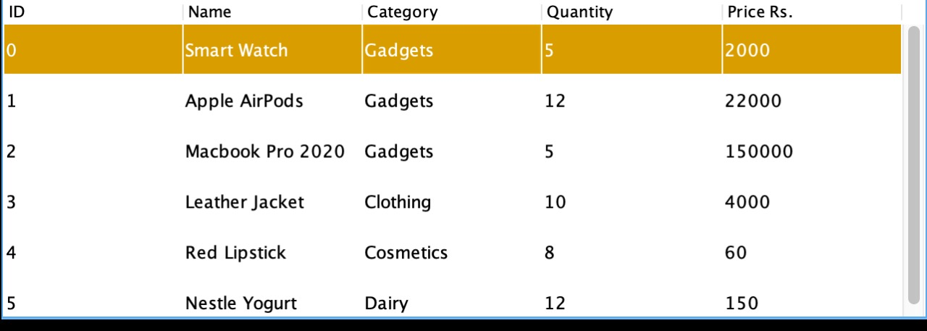
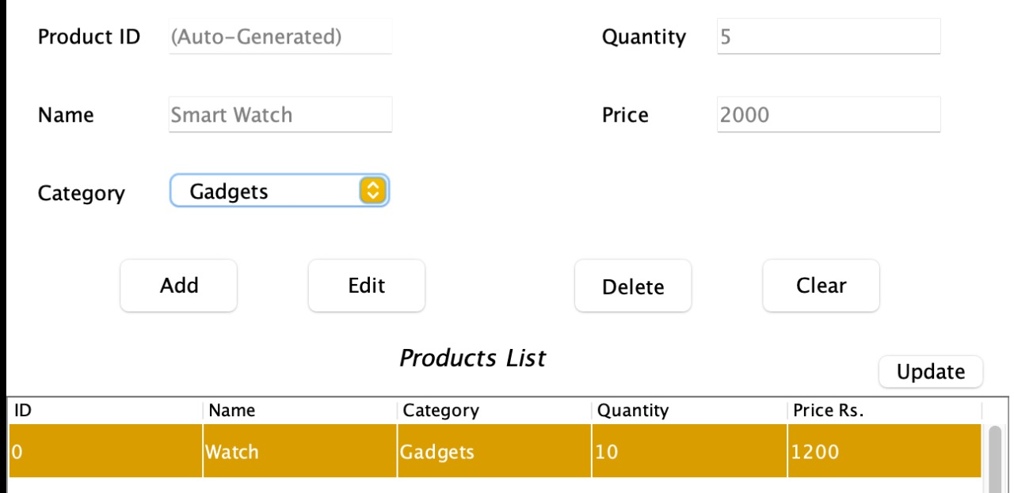
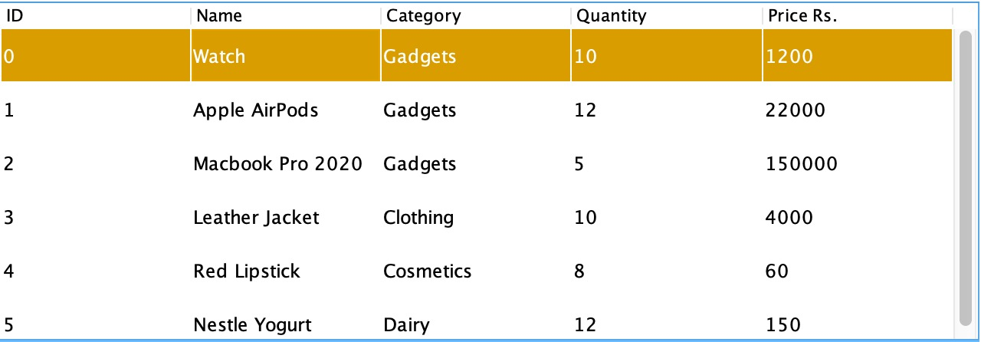
Editing Stock

Slide 12
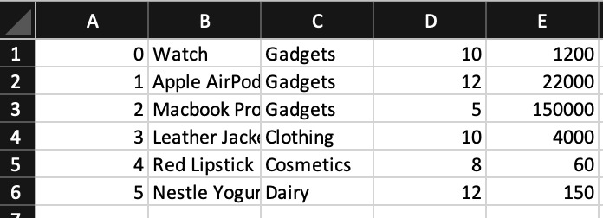
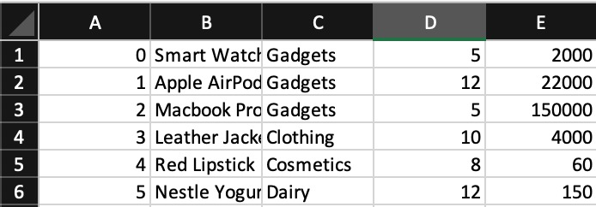
Meanwhile in CSV

Slide 13
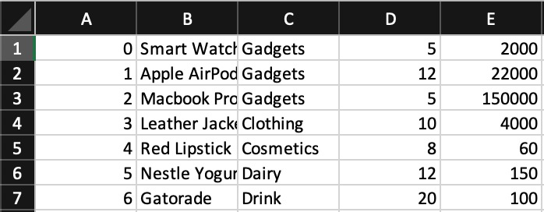
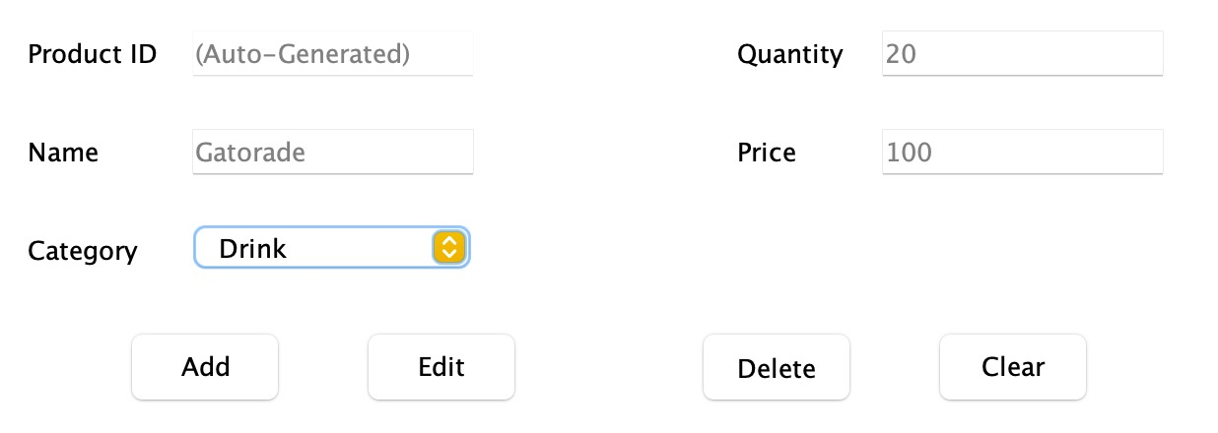
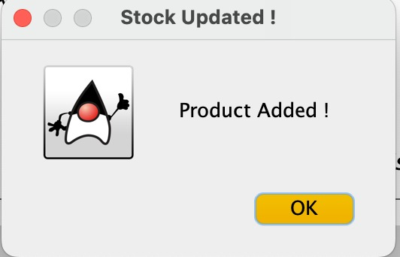
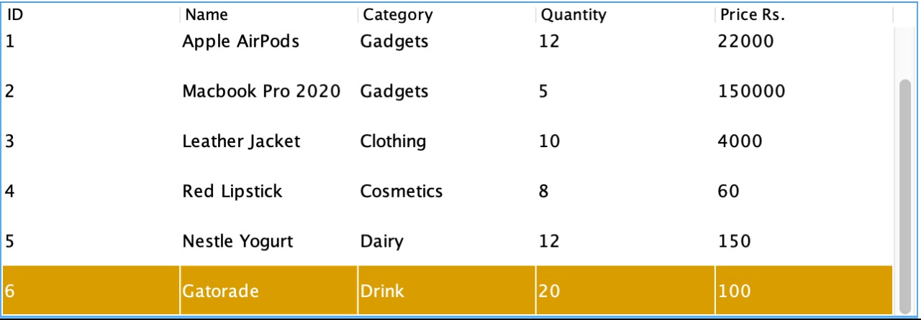
Adding New Product

Slide 14
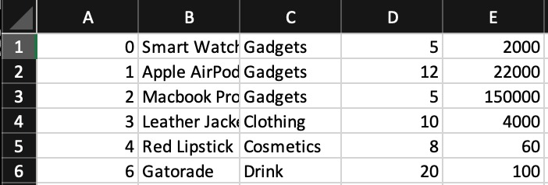
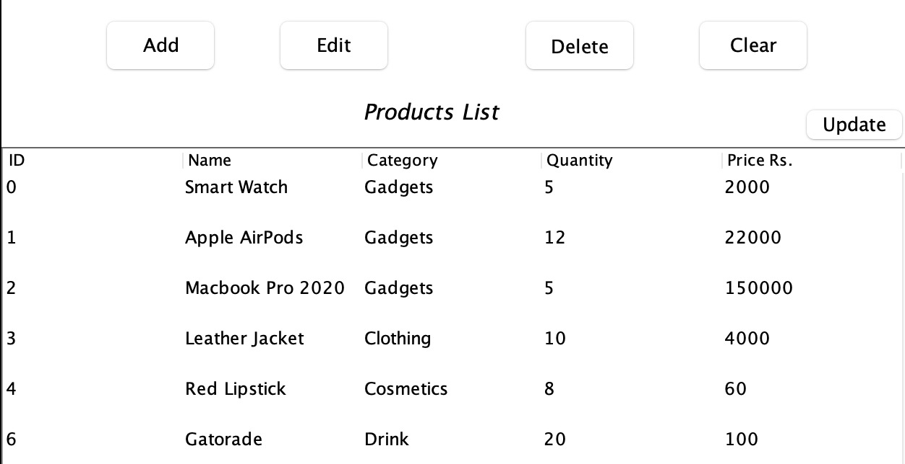
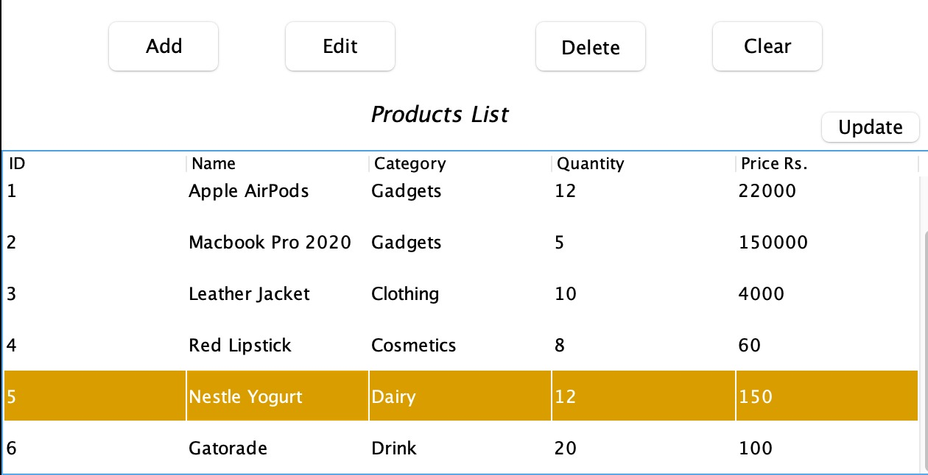
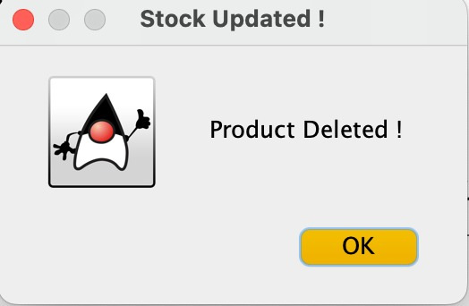
Deleting Product

Slide 15
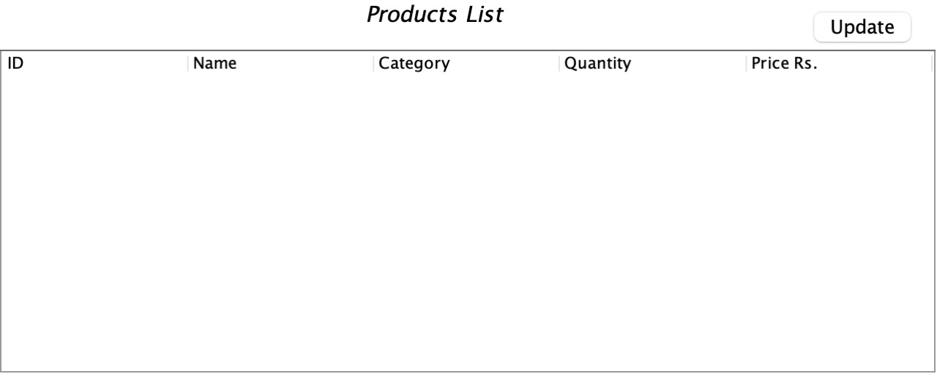
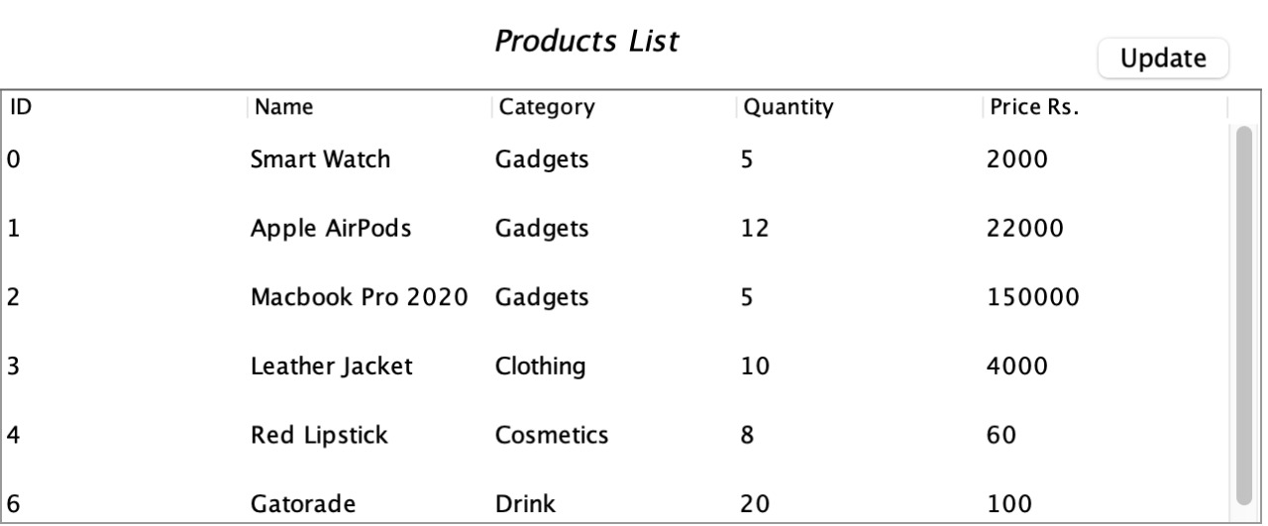
Updating Stock

Slide 16
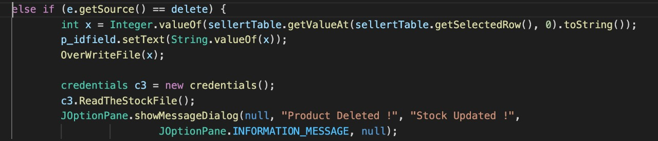
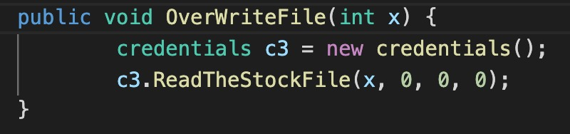
Meanwhile In The Backend

Slide 17
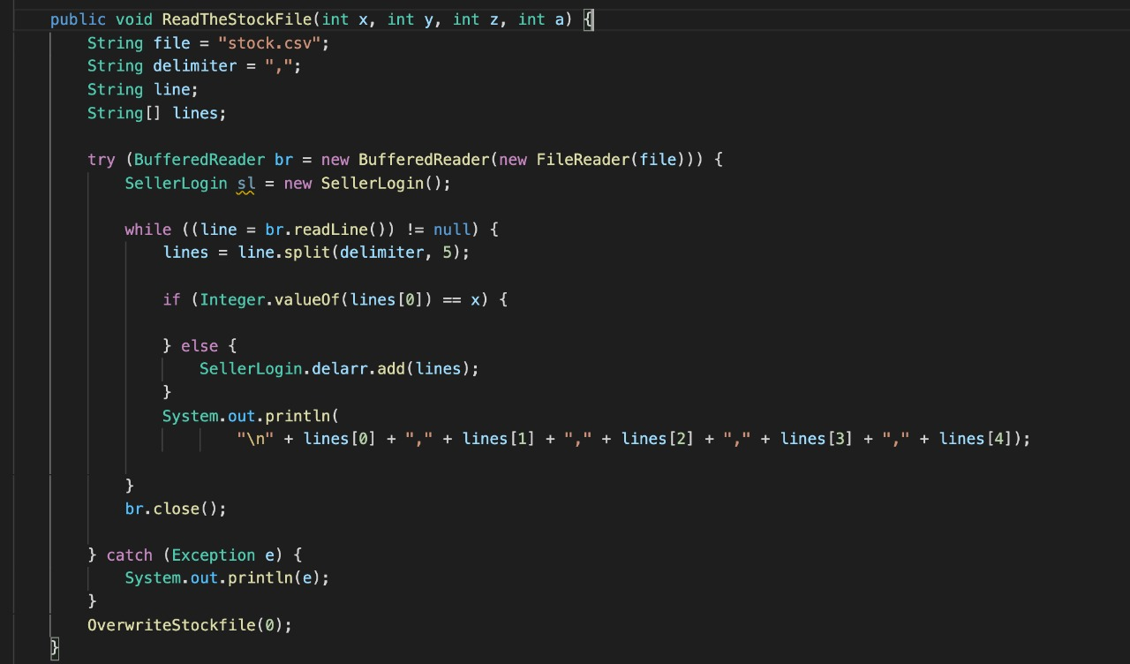
Read the stock from file - Delete

Slide 18
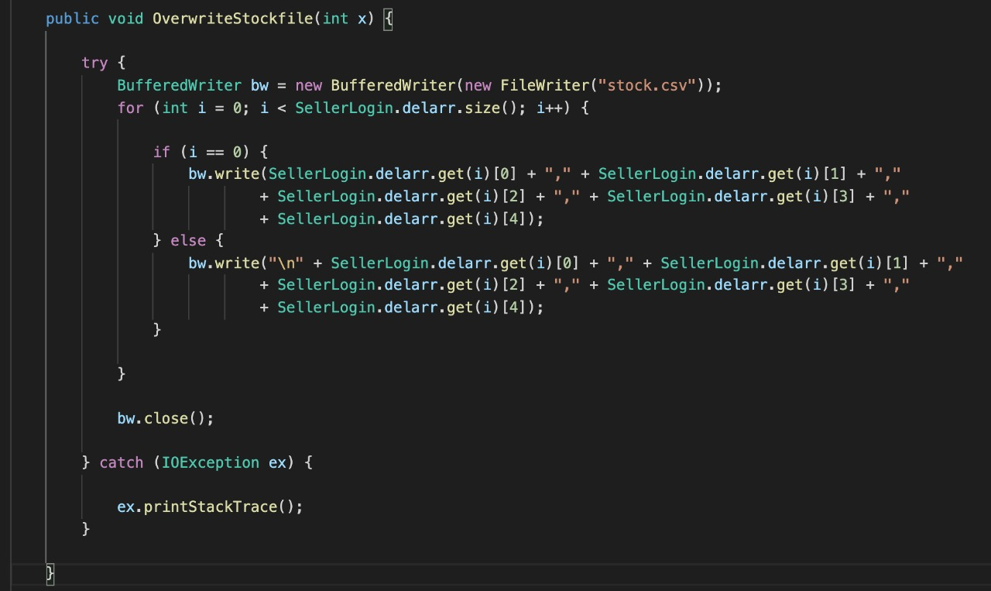
Overwriting Stock File

Slide 19
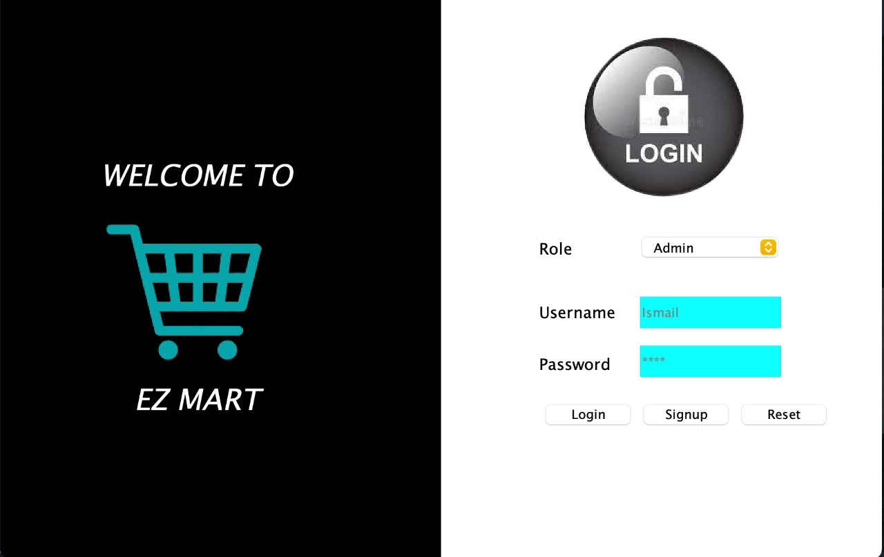
SNEAK PEEK

Slide 20
NOW LETS JUMP TO THE DEMONSTRATION

